Slide 1
TYPES OF CROPS
© Aviyal Presentations : https://aviyalpresentations.wordpress.com/

Slide 2
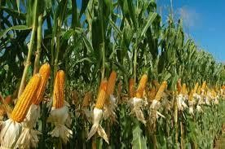
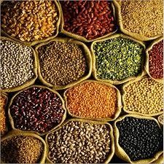
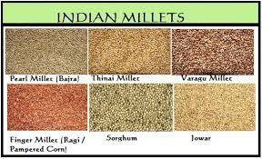
CROPS IN INDIA
Agriculture plays a vital role in the Indian economy.
Agriculture is the backbone of our country.
Two-third of the total population of India is engaged in agricultural activities.
India is a top producer country of many crops.
Some of the major crops produced here are wheat, rice, cotton, sugarcane and also tea, spices, etc.
© Aviyal Presentations : https://aviyalpresentations.wordpress.com/

Slide 3
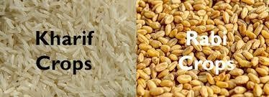
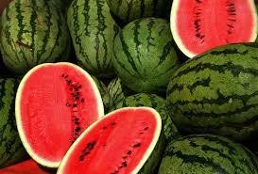
CLASSIFICATION OF CROPS
Crops are classified into following three categories based on season:
  Kharif crops
  Rabi crops
  Zaid crops
Zaid Crops
© Aviyal Presentations : https://aviyalpresentations.wordpress.com/

Slide 4
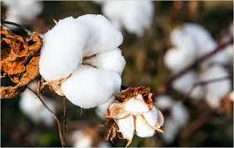
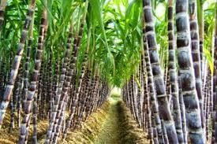
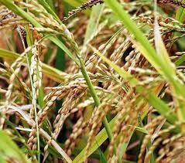
CLASSIFICATION OF CROPS
1. Kharif Crops
Kharif means "autumn" in Arabic.
Also known as monsoon crops.
Sown in: June (beginning of monsoon)
Harvested in: November (end of monsoon)
dependent on quantity of rain and water
Examples: Cotton, Soyabean, Sugarcane, Turmeric, Paddy (Rice), Maize, Moong (Pulses), Groundnut, Red Chillies
Cotton
Sugarcane
Paddy
© Aviyal Presentations : https://aviyalpresentations.wordpress.com/

Slide 5
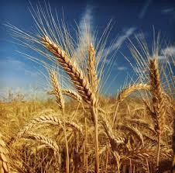
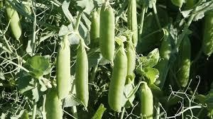
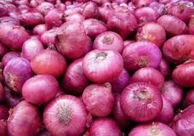
2. Rabi Crops
Rabi means “spring" in Arabic.
Also known as winter crop.
Sown in: mid- November(end of monsoon)
Harvested in: April/May
The crops are grown either with rainwater that has percolated into the ground, or with irrigation.
Examples: barley, wheat, pea, onion, tomato
Pea
Onion
Barley
© Aviyal Presentations : https://aviyalpresentations.wordpress.com/

Slide 6
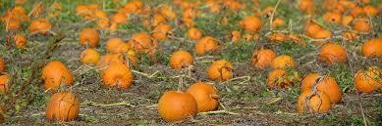
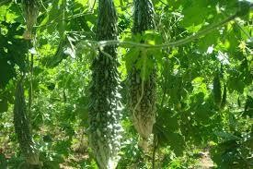
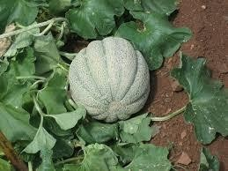
3. Zaid Crops
Also known as “summer crops”.
Grown: March to June(between Kharif and Rabi)
They require warm dry weather for major growth period and longer day length for flowering.
Examples: Pumpkin, bitter guard, muskmelon, watermelon, cucumber
Pumpkin
Bitter guard
Musk melon
© Aviyal Presentations : https://aviyalpresentations.wordpress.com/

Slide 7
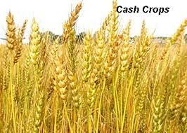
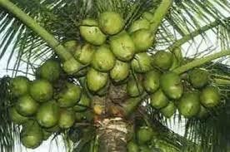
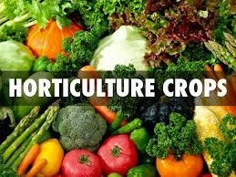
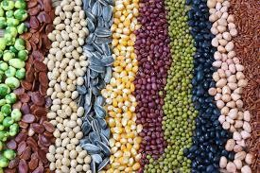
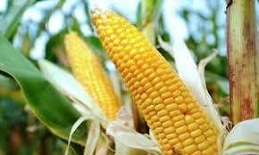

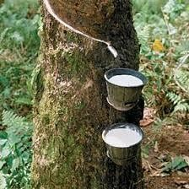
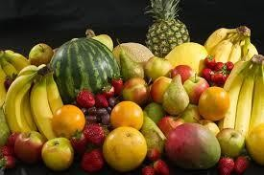
CLASSIFICATION OF CROPS
Crops are classified into the following four categories based on their usage.
Food crops(Crop grown for human consumption.)
Cash crops(crop which is grown for sale to return a profit.)
Plantation crops (Crops grown large land areas called plantations for sale to return a profit .)
Horticulture crops
Cash crops
Plantation crops
Horticulture crops
Food crops
/
© Aviyal Presentations : https://aviyalpresentations.wordpress.com

Slide 8
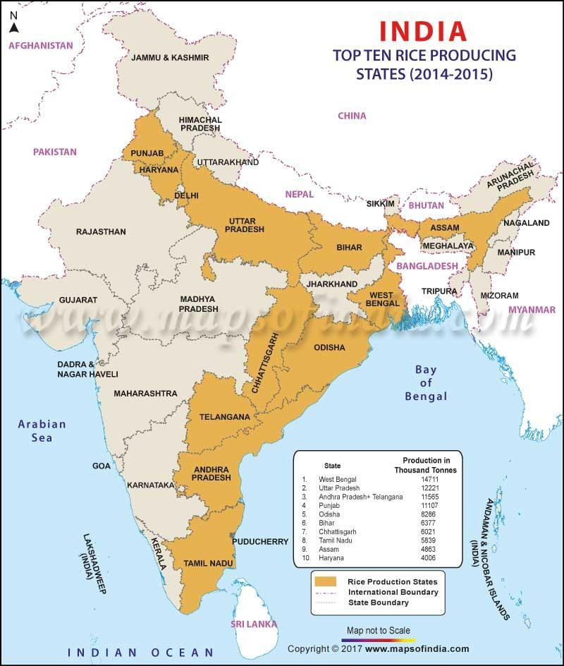
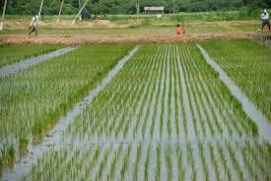
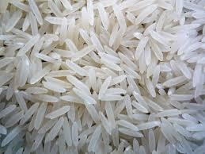
MAJOR CROPS IN INDIA
Rice
  It’s the staple crop of India.
  India is the 2nd largest producer of rice in the world.
  Type of crop: Kharif, Rabi
  Temperature: 16°C – 27°C
  Rainfall : 100 cm to 200 cm
  Soil: rice is grown well on the alluvial soil or on the fertile river basins. It is also grown in mixed soil or loamy and clayey soil.
  States: West Bengal, Bihar, Orissa, Andhra Pradesh, Tamil Nadu, Kerala, Assam, Uttar Pradesh, Punjab.
© Aviyal Presentations : https://aviyalpresentations.wordpress.com/

Slide 9
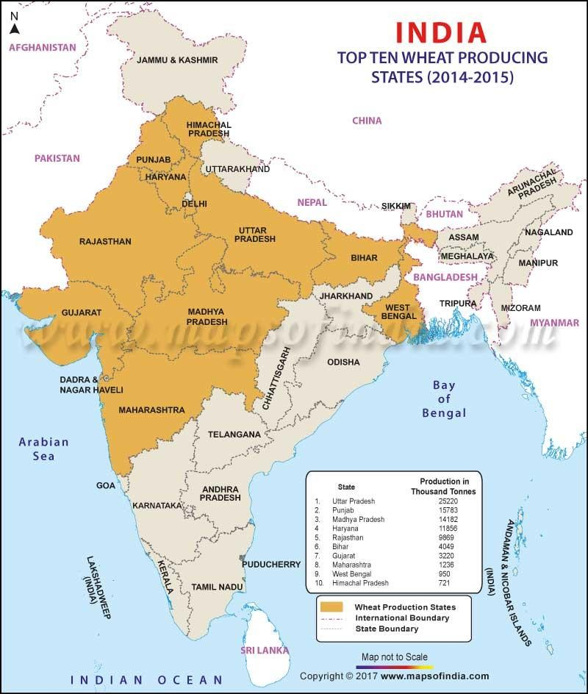
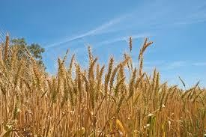
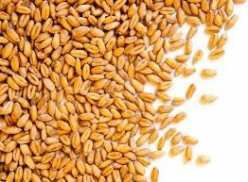
Wheat
  It is the 2nd most important food crop in India.
  India is second in production of wheat worldwide.
  Type of crop: Rabi
  Temperature: 17-20 °C
  Rainfall: 20-100 cm (ideal is 75 cm)
  States: U.P., Punjab, Haryana, Madhya Pradesh, Rajasthan, Bihar, West Bengal, Gujarat, Himachal Pradesh and Maharashtra

Slide 10
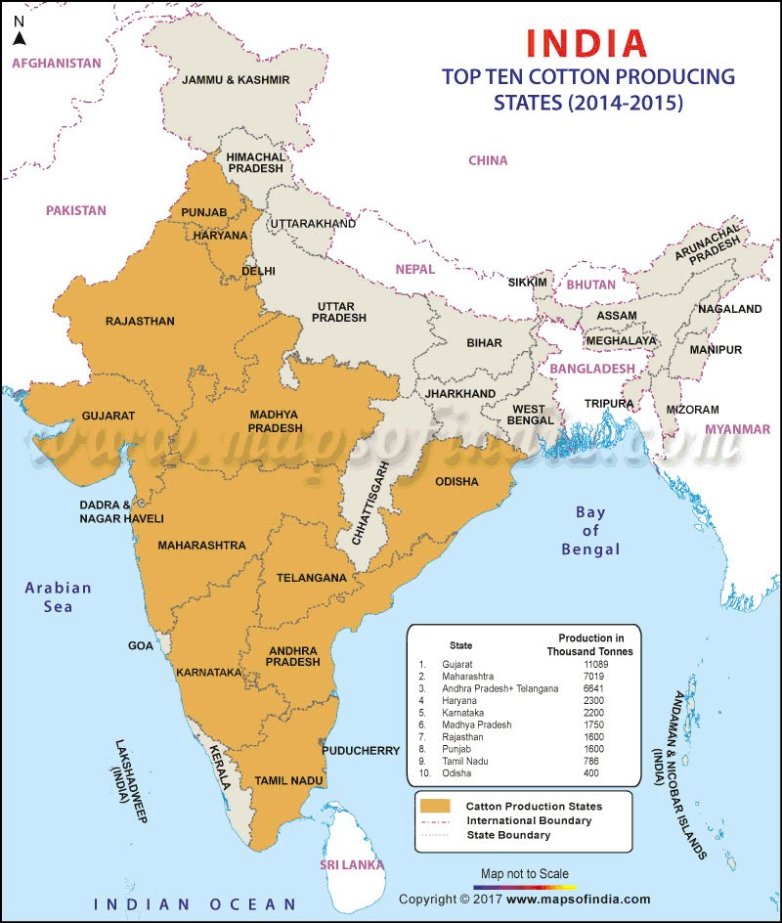
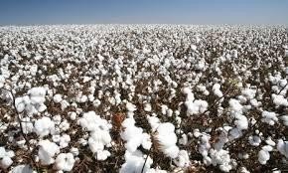
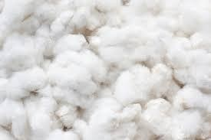
Cotton
  It is a fiber crop and is known as ‘White gold’.
  India is 3rd in the production of cotton worldwide.
  Type of Crop: Kharif
  Temperature: 21°C to 30°C
  Rainfall: 60 to 120 cm
  States: Gujarat, Maharashtra, Andhra Pradesh, Haryana, Madhya Pradesh, Punjab, Rajasthan, Karnataka, Tamil Nadu, Odisha

Slide 11
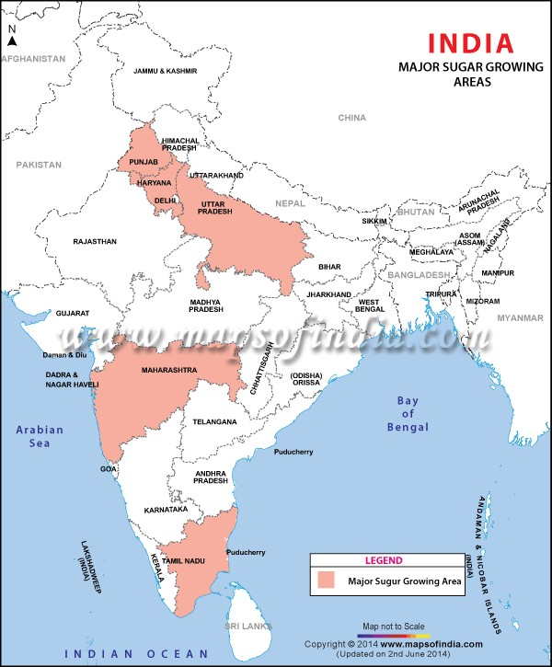
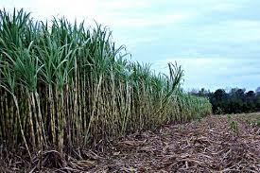
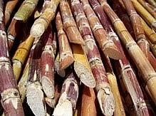
Sugarcane
  Sugarcane is an important cash crop.
  India stands at 2nd position among all countries in the world in its production.
  Type of crop: Kharif, Rabi
  Temperature: 20-26 °C
  States: Uttar Pradesh, Maharashtra, Tamil Nadu, Haryana, Punjab

Slide 12
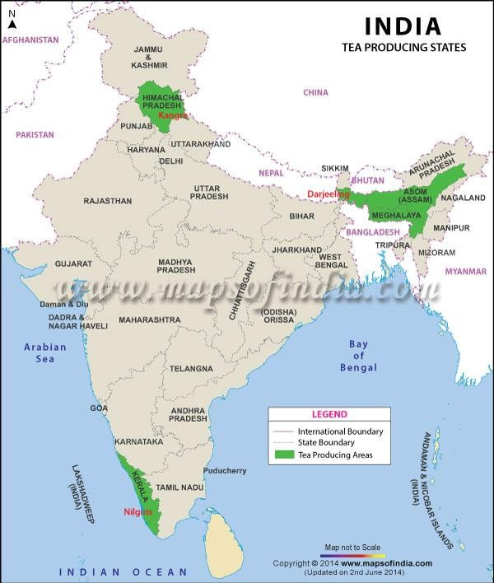
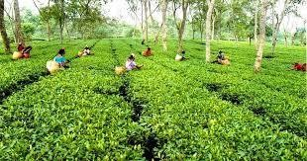
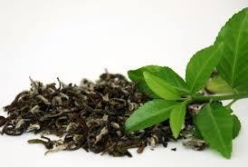
Tea
  It’s a labour intensive crop and 50% of the employees are women.
  India is the 2nd largest producer and the largest consumer of tea in the world.
  Temperature: 20-30 °C
  Rainfall: 150-300 cm
  States: Kerala, Assam, Meghalaya, Himachal Pradesh

Slide 13
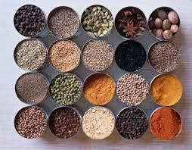
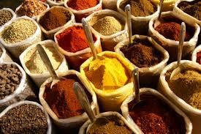
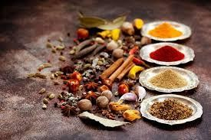
Spices
  Temperature: 10-30 °C
  Rainfall: 200-300 cm
  Some of the spices produced in India (state wise) are:
    Cardamom (Queen of Aromatic Spices) – Assam, Kerala, Tamil Nadu
    Pepper (King of Spices) – Kerala
    Chillies – Andhra Pradesh, Maharashtra, Odisha, Rajasthan
    Turmeric – Andhra Pradesh, Karnataka, Tamil Nadu
    Nutmeg – Kerala
    Areca nut – Kerala, Karnataka, Tripura, Assam
    Cinnamon – Kerala
    Clove – Kerala

Slide 14
CONCLUSION
India is the second largest producer of various crops.
India has a diverse variety of crops grown in different seasons.
If the problems faced in the agriculture field are overcome by the use of various strategies , we
can become the no. 1 producer and exporter in the world.

Slide 15
THANK YOU!

